Slide 1
Equal Opportunity (EO) and Nondiscrimination Responsibilities
The laws, complaints processes and guidance for improved program access

Slide 2
Agenda
EO responsibilities and laws
Key EO Personnel
Complaint Process
EO Tools and Forms

Slide 3
Overview
As subrecipients and contractors of Federally-funded programs and activities, we have a responsibility to provide meaningful access and equal opportunity to services.

Slide 4
The big picture
Section 188 of the Workforce Innovation and Opportunity Act (WIOA) (amending the Workforce Investment Act (WIA)) requires nondiscrimination and equal opportunity in the administration, oversight and delivery of WIA/WIOA-related:
Services
Aid
Benefits
Training
Employment practices (i.e., positions with your agency or company that are funded with WIOA dollars)

Slide 5
Who is included?
Registrants
Program applicants
Program participants
Sub-contractors
Service providers
Employees
Applicants for employment

Slide 6
Our responsibilities
Provide notice that indicates:
That NCWWDB and its service providers (recipients of federal funding) do not discriminate on protected bases
How to contact the NCWWDB Equal Opportunity Officer and AJC Complaint Coordinator
Information about the complaint procedures
Adopt grievance (complaint) procedures to handle complaints of discrimination or program violations

Slide 7
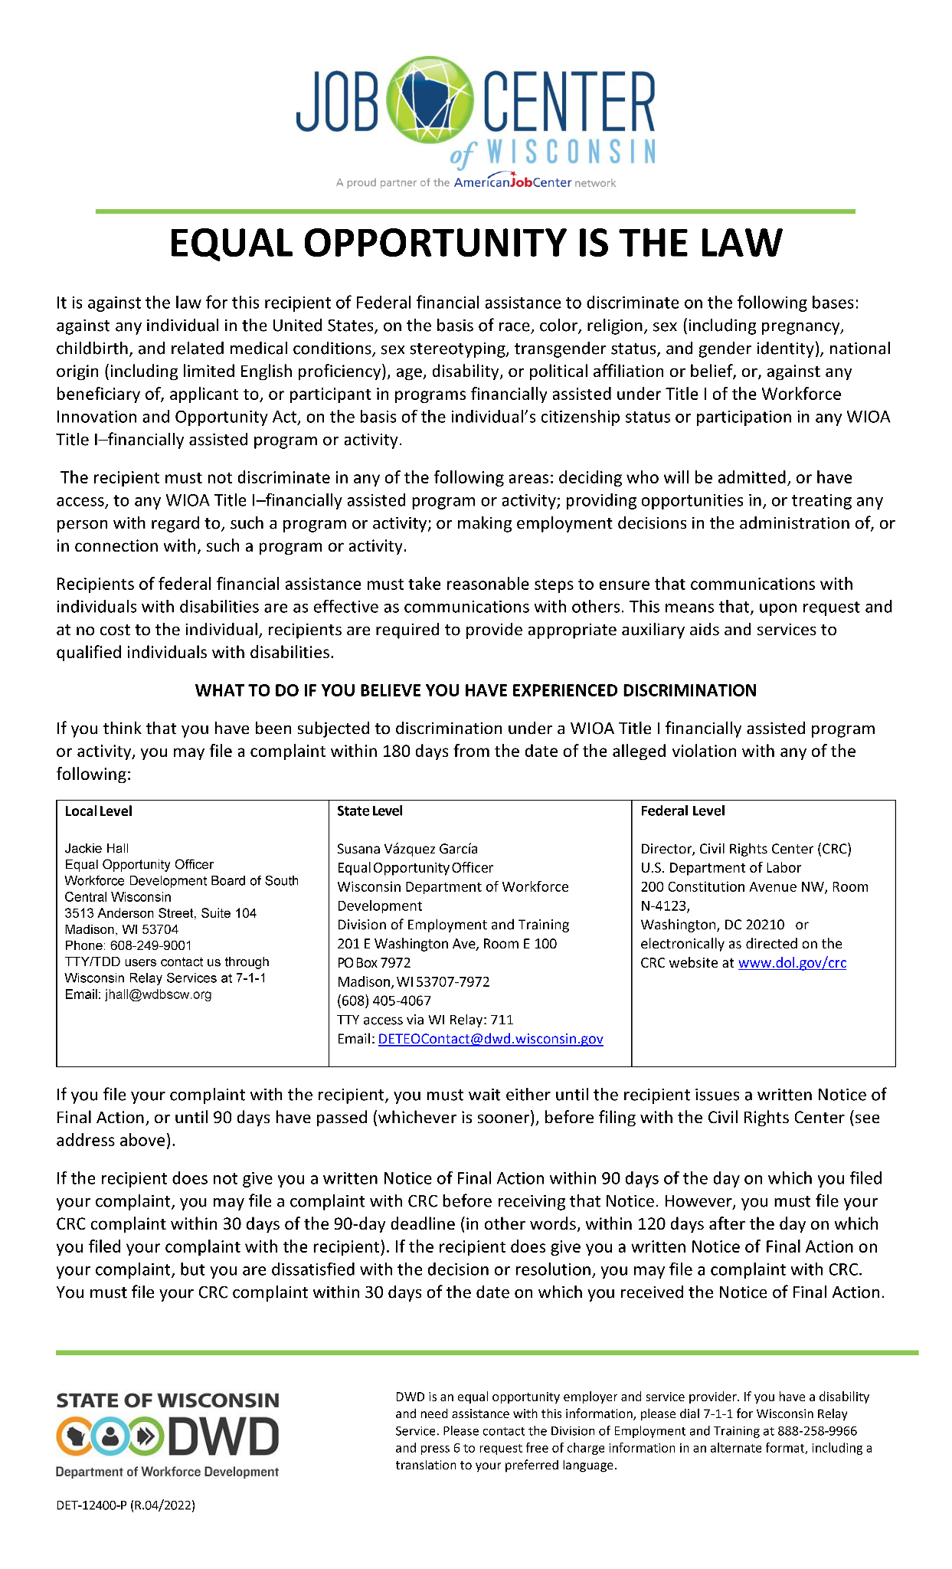
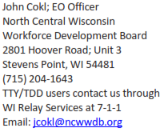
Equal Opportunity is the Law

Slide 8
The laws
Federal civil rights laws prohibit discrimination of members, applicants, enrollees, and beneficiaries in programs and activities that receive Federal financial assistance.
The laws include:
Title VI of the Civil Rights Act of 1964
Section 504 of the Rehabilitation Act of 1973
Americans with Disabilities Act of 1990,
Title IX of the Educational Amendments of 1972
Age Discrimination Act of 1975
Section 1557 of the Patient Protection and Affordable Care Act of 2010

Slide 9
The laws that apply
These laws prohibit recipients and subrecipients of Federal financial assistance from discriminating on the basis of: race, color, national origin (including limited English proficiency), disability, any age, gender, citizenship, political affiliation or belief, religion, sex (including pregnancy, childbirth, and related medical conditions, sex stereotyping, transgender status, gender identity), WIOA participant status
Retaliation is prohibited by all of the laws
29 CFR § 37.5; 29 CFR § 38.25

Slide 10
Assurances
29 C.F.R. § 38.25
Equal Opportunity Is the Law
It is against the law for this recipient of Federal financial assistance to discriminate on the following bases: Against any individual in the United States, on the basis of race, color, religion, sex (including pregnancy, childbirth, and related medical conditions, sex stereotyping, transgender status, and gender identity), national origin (including limited English proficiency), age, disability, or political affiliation or belief, or, against any beneficiary of, applicant to, or participant in programs financially assisted under Title I of the Workforce Innovation and Opportunity Act, on the basis of the individual's citizenship status or participation in any WIOA Title I-financially assisted program or activity….

Slide 11
Assurances
29 C.F.R. § 38.25
The recipient must not discriminate in any of the following areas:
Deciding who will be admitted, or have access, to any WIOA Title I-financially assisted program or activity;
providing opportunities in, or treating any person with regard to, such a program or activity; or
making employment decisions in the administration of, or in connection with, such a program or activity.

Slide 12
Assurances
29 C.F.R. § 38.25
Recipients of federal financial assistance must take reasonable steps to ensure that communications with individuals with disabilities are as effective as communications with others. This means that, upon request and at no cost to the individual, recipients are required to provide appropriate auxiliary aids and services to qualified individuals with disabilities.
Notes:
This also includes providing information to LEP individuals in their preferred language.

Slide 13
Assurances
29 C.F.R. § 38.25
What To Do If You Believe You Have Experienced Discrimination
If you think that you have been subjected to discrimination under a WIOA Title I-financially assisted program or activity, you may file a complaint within 180 days from the date of the alleged violation with either:
The recipient's Equal Opportunity Officer (or the person whom the recipient has designated for this purpose); or
The Director, Civil Rights Center (CRC), U.S. Department of Labor, 200 Constitution Avenue NW., Room N-4123, Washington, DC 20210 or electronically as directed on the CRC Web site at www.dol.gov/crc.

Slide 14
Assurances
29 C.F.R. § 38.25
If you file your complaint with the recipient, you must wait either until the recipient issues a written Notice of Final Action, or until 90 days have passed (whichever is sooner), before filing with the Civil Rights Center (see address above).
If the recipient does not give you a written Notice of Final Action within 90 days of the day on which you filed your complaint, you may file a complaint with CRC before receiving that Notice. However, you must file your CRC complaint within 30 days of the 90-day deadline (in other words, within 120 days after the day on which you filed your complaint with the recipient).
If the recipient does give you a written Notice of Final Action on your complaint, but you are dissatisfied with the decision or resolution, you may file a complaint with CRC. You must file your CRC complaint within 30 days of the date on which you received the Notice of Final Action.

Slide 15
How wide is the net?
The laws apply to our entire system for delivering WIOA Title I-assisted aid, training or benefits--from start to finish including, but not limited to:
Recruitment, outreach, contracting and procurement, enrollment, grants, training, OJT, testing and referrals for counseling, education, training or employment
Remember: WIOA is not an entitlement program, per WIOA sec. 134(c)(3)(A), but we need to ensure fair access.

Slide 16
Complaints

Slide 17
Types of complaints
Customer Service Complaints
Expression of dissatisfaction with service
Ex: Customer unhappy that funding has been denied for an unapproved training program
WIOA Program Complaints (365 days to file a complaint)
Serious violation of a program rule or process in the complainant’s situation
Ex: Customer denied access to a WIOA Title I registrant level service because of his income status
Discrimination Complaints (180 days to file a complaint)
Serious violation of discrimination based on a protected class under federal EO laws
Ex: Customer was denied a service because of a disability that required an accommodation
Fraud and Abuse Complaints
Serious violation of misused resources
Ex. Embezzlement or misappropriation of funds, conflicts of interest involving program administrators
Notes:
A program complaint and a discrimination complaint can look alike. Both types of complaints include an issue, something the individual is complaining about. The ingredient that makes a discrimination complaint different from a program complaint is that, in addition to an issue, a discrimination complaint includes a basis. A basis is the complainant's reason for his/her treatment. A complaint is a discrimination complaint if it includes, as a reason for the mistreatment, one of the prohibited factors listed in WIOA Section 188 (e.g., race, color, sex, etc.). A complaint cannot be processed as both a program complaint and as a discrimination complaint.

Slide 18
Informal Resolution
Complaints should first be initiated at the local level. This means the complaint can be made to:
A Career Planner
The Career Planner’s supervisor
The American Job Center Complaint Coordinator, or
The NCWWDB Equal Opportunity Officer
The preferred outcome is to reach a mutually satisfactory resolution to the complaint through negotiation, problem solving and other available resolution resources at the local level. Fact: All complaints made last year were resolved by the informal resolution process.

Slide 19
Diffusing a complaint
Be an active listener
Take notes and gather information. (Separate emotion, don’t make any immediate judgements or decisions)
Acknowledge the complaint
Let the individual (or group) know that you’re glad this matter was brought to your attention,
That we take the complaint seriously and will investigate the situation
We will keep the complaint confidential to the extent possible
Restate what you heard to ensure you understand the complaint
Offer solutions or options, or involve a supervisor for help in resolving the complaint informally
Document the conversation (with facts--no fluff!) into ASSET in case note or in writing for recordkeeping
Notify your supervisor and the EOO if you are unable to resolve the issue
Keep complaints confidential to the extent possible

Slide 20
Key EO contacts
NCWWDB Equal Opportunity Officer
John Cokl, Equal Opportunity Officer
(715) 204-1643
JCOKL@NCWWDB.org

Slide 21
Formal Complaint Process
If a complaint cannot be resolved informally, then a complainant may file a formal complaint. (Note: this process is not for a general complaint, but for severe violations of program rules or discrimination.)
Submit Complaint Form Complainants must first complete the Complaint Form and submit to the NCWWDB EO Officer. Note: A program-related complaint must be filed within one year of the alleged violation. Conversely, a discrimination complaint must be filed within 180 days of the alleged act.
Confirmation of Receipt The NCWWDB EO will confirm receipt of the complaint and will review the complaint for validity.
Review and Resolution If the complaint is deemed valid, the NCWWDB EO will work to resolve the matter and provide a written decision within 20 days of the filing date. If the complaint is rejected, the NCWWDB will provide written notice of reason(s) the complaint was rejected.

Slide 22
Formal Complaint Process (continued)
Appeal Complainants that do not receive a decision or if either party (complainant or respondent)is dissatisfied with the decision within the prescribed timeline may appeal to the NCWWDB in writing.
Hearing and Decision A hearing will be conducted with NCWWDB Board representation within 60 days from the date the complaint was filed, and a decision shall be rendered within this 60-day timeline.
Appeal to the State Dept. of Workforce Development A hearing decision may be appealed to the State within 10 calendar days of the decision or 15 days calendar days after the due date if no decision was received.

Slide 23
Complaint process
20 days
60 days
Formal complaint submitted
EOO confirms receipt
EOO reviews complaint, issues decision
Appeal to NCWWDB
Hearing, committee issues decision
Appeal to State Dept. of Workforce Development
Notes:
EOO must confirm receipt within 5 days of receipt. EOO will review for validity and issue decision within 20 days of filing date. If the decision received is dissatisfactory (or is not received), the complainant may appeal no later than 5 days of decision due date (25 days from filing date). The appeal process includes a hearing with NCWWDB Board representation, and must be conducted and decision issued within 60 days of filing date (no later than 35 days from appeal).

Slide 24
Meaningful access to limited English proficient (LEP) individuals

Slide 25
What the Regulations state
29 CFR § 38.9(b)
Requires recipients to take reasonable steps to ensure meaningful access to each (LEP) individual served or encountered so that LEP individuals are effectively informed about and/or able to participate in the program or activity.
Reasonable steps include, but are not limited to, an assessment of the LEP individual to determine language assistance needs, providing oral or written translation, and outreach to LEP communities to improve service delivery in needed languages.

Slide 26
What can we do?
Develop and maintain an LEP Plan for our WDA
It’s available from the NCWWDB Equal Opportunity Officer
Identify customers that have a primary (preferred) language other than English (noted in the Programs screen in ASSET)
Be sure to offer language service to the customer without delay
If the customer declines language services:
Document this in an ASSET case note
If the customer needs services (based on assessment), please utilize available tools like LanguageLine.
To access LanguageLine dial 1-866-874-3972, enter Client ID: 506175
Notes:
LEP Plan:
Clear framework and language assistance plan to ensure meaningful access to LEP customers (hey - it’s the law!)
This Plan must show the process(es) we take to identify, inform and provide language services to LEP individuals
The plan also factors in components like staff training (like this one), monitoring / quality assurance, policies, timelines, and stakeholder review

Slide 27
What do I need to remember?

Slide 28
Key takeaways
Know your responsibilities and the laws that apply
Seek informal resolution whenever possible, involving supervisors for support
Know your EOO contacts
Keep complaints confidential (breach of confidentiality is on the rise)
Feel free to contact NCWWDB EO Officer at any time.
Notes:
Your agency is liable

Slide 29
Changes in the paperwork
Program Rights and Responsibilities
EO is the law notice
The participant statement signature page now includes acknowledgement of the right to nondiscrimination and equal opportunity and the complaint procedures
This signed form must be retained in participant file
EO is the Law Notice
Must be retained in the participant file
Notice is included in the WIOA application packet
Babel Notice
Now included with all WIOA vital documents to ensure customers are notified of their right to language assistance

